Slide 1
Single-timescale Single-loop TD
Yanjie Ze
July 2021

Slide 2
Catalogue
1 Motivation
2 Notation
3 Algorithm
4 Assumption
5 Convergence Metric
6 Theoretical Results
7 Proofs for Algorithm 2
8 Proofs for Lemmas

Slide 3
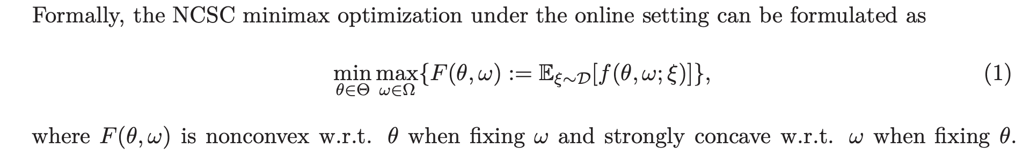
1 Motivation
Then, this work aims to answer two questions:
Is it possible to design a single-timescale and single-loop stochastic algorithm for the problem (1)?
Moreover, can we further accelerate this algorithm to obtain a lower sample complexity?

Slide 4
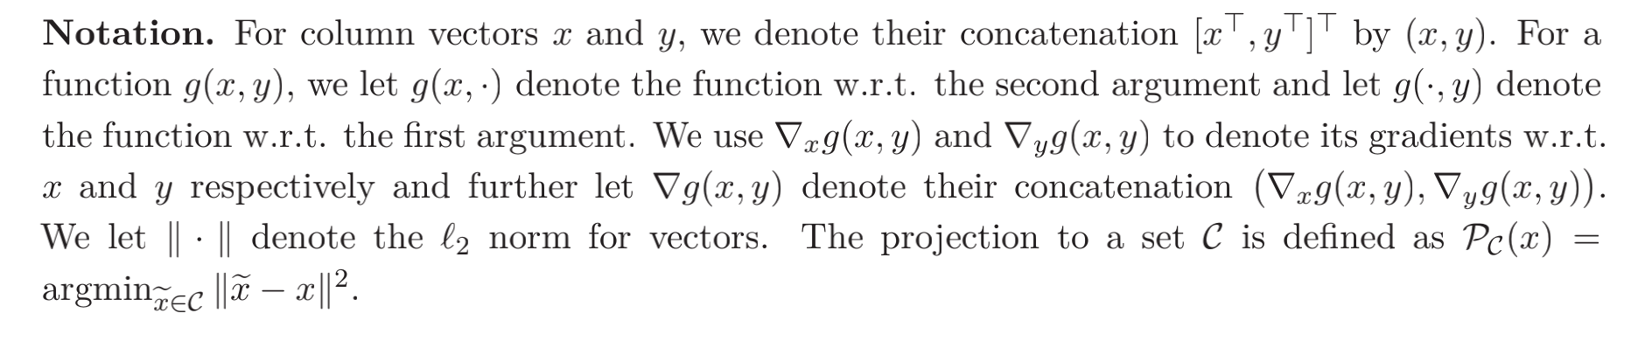
2 Notation

Slide 5
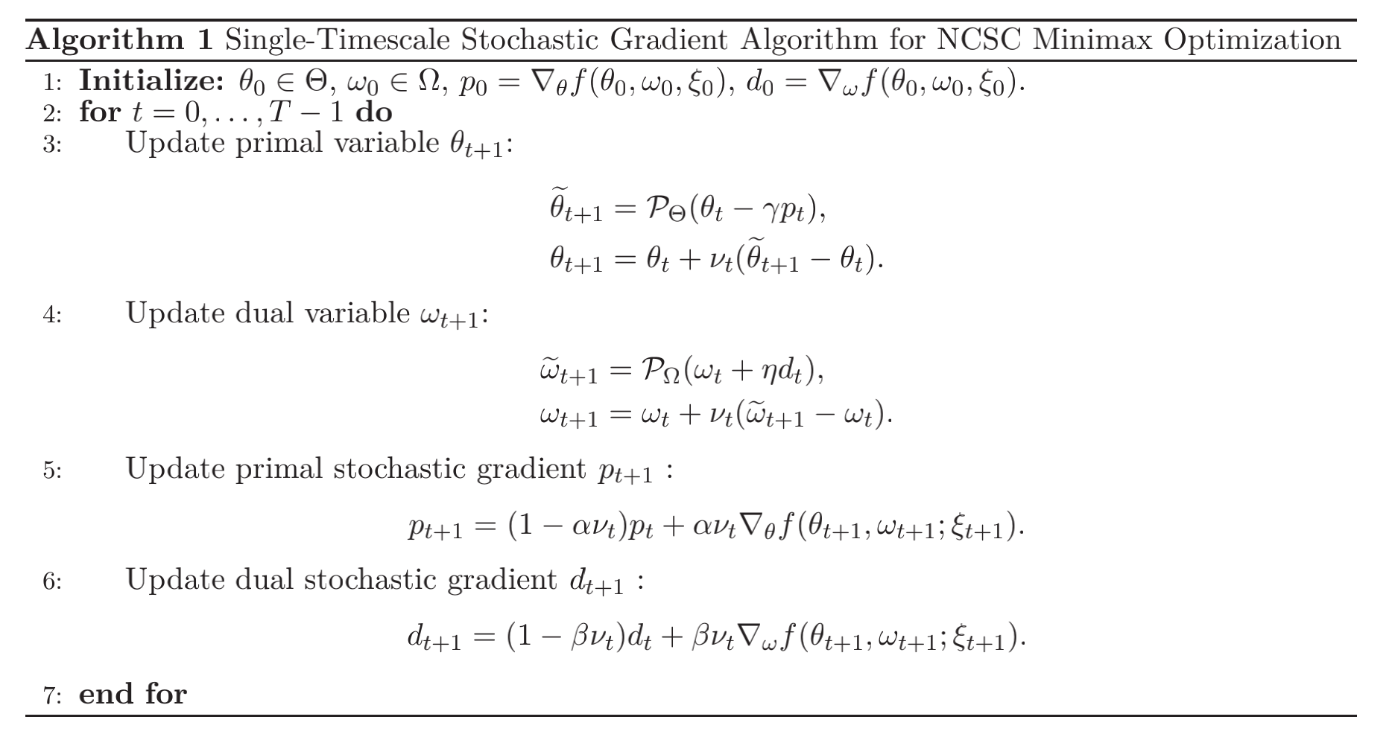
3.1 Algorithm 1

Slide 6
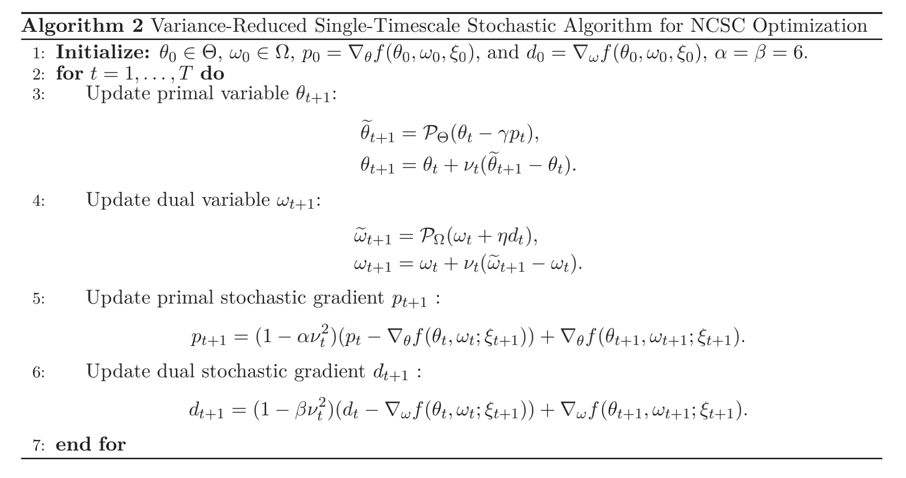
3.2 Algorithm 2 (Accelerated)

Slide 7
4.1 Assumption for Algorithm 1

Slide 8
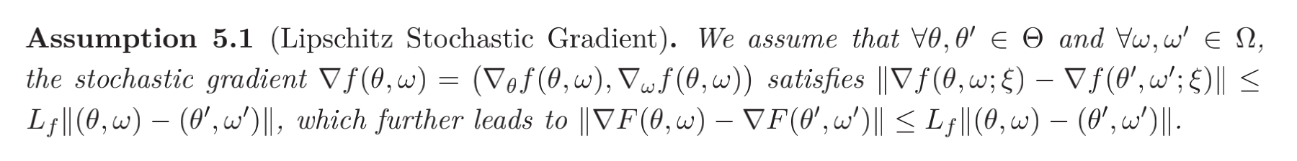
4.2 Assumption for Algorithm 2
For Algorithm 2, we replace L-lipschitz gradient with stochastic L-lipschitz gradient.

Slide 9
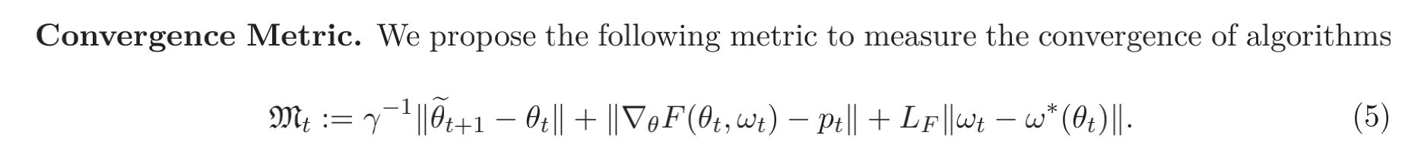
5 Convergence Metric

Slide 10
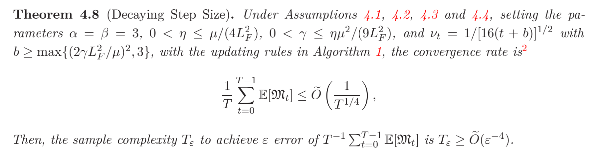
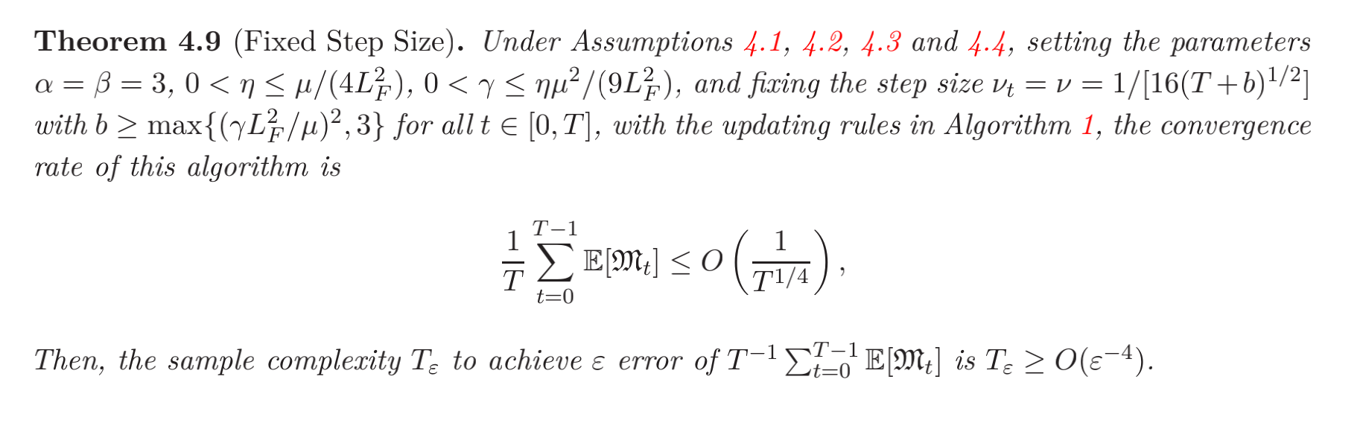
6.1 Theoretical Results for Alg1

Slide 11
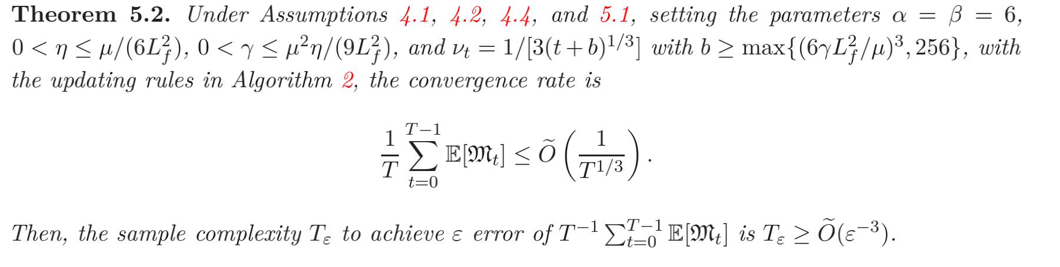
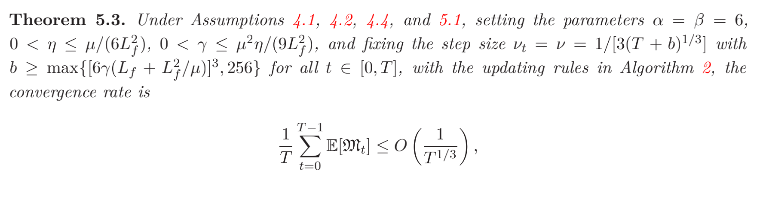
6.2 Theoretical Results for Alg2

Slide 12
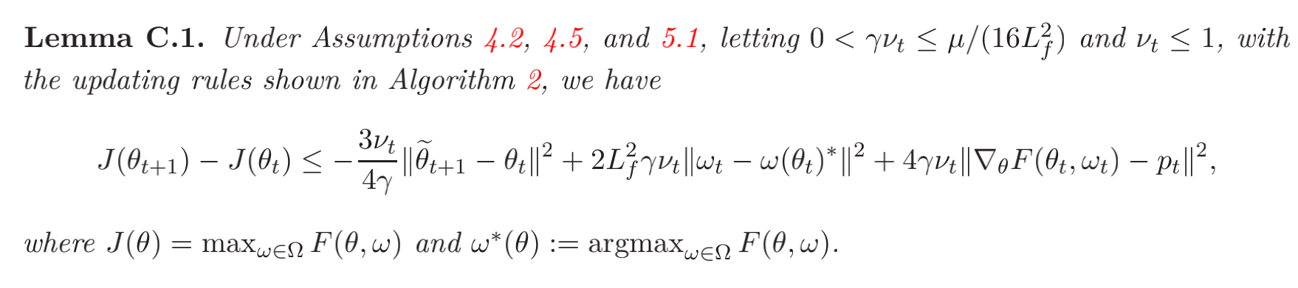
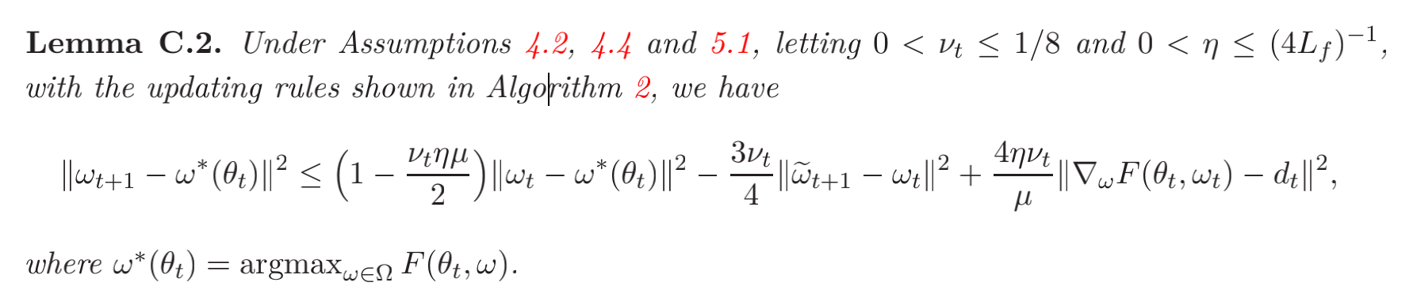
7 Proofs for Algorithm 2
Before the proof, we introduce some lemmas.

Slide 13
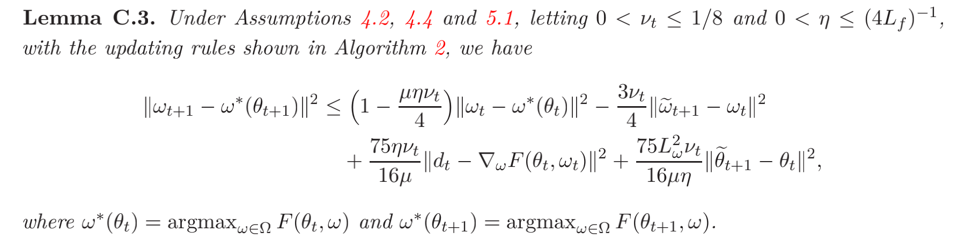
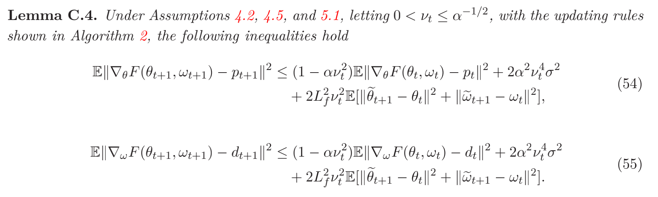
7 Proofs for Algorithm 2

Slide 14
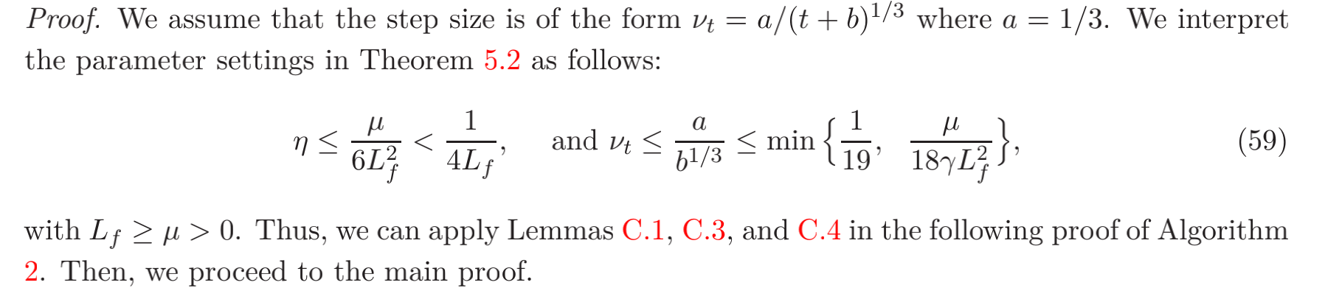
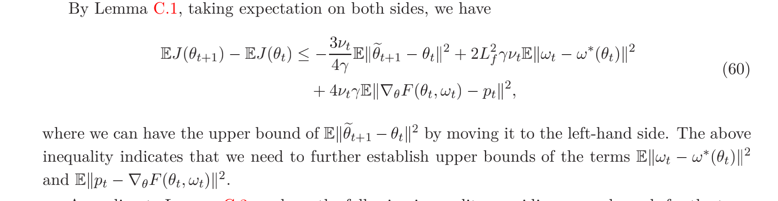
7 Proofs for Algorithm 2

Slide 15
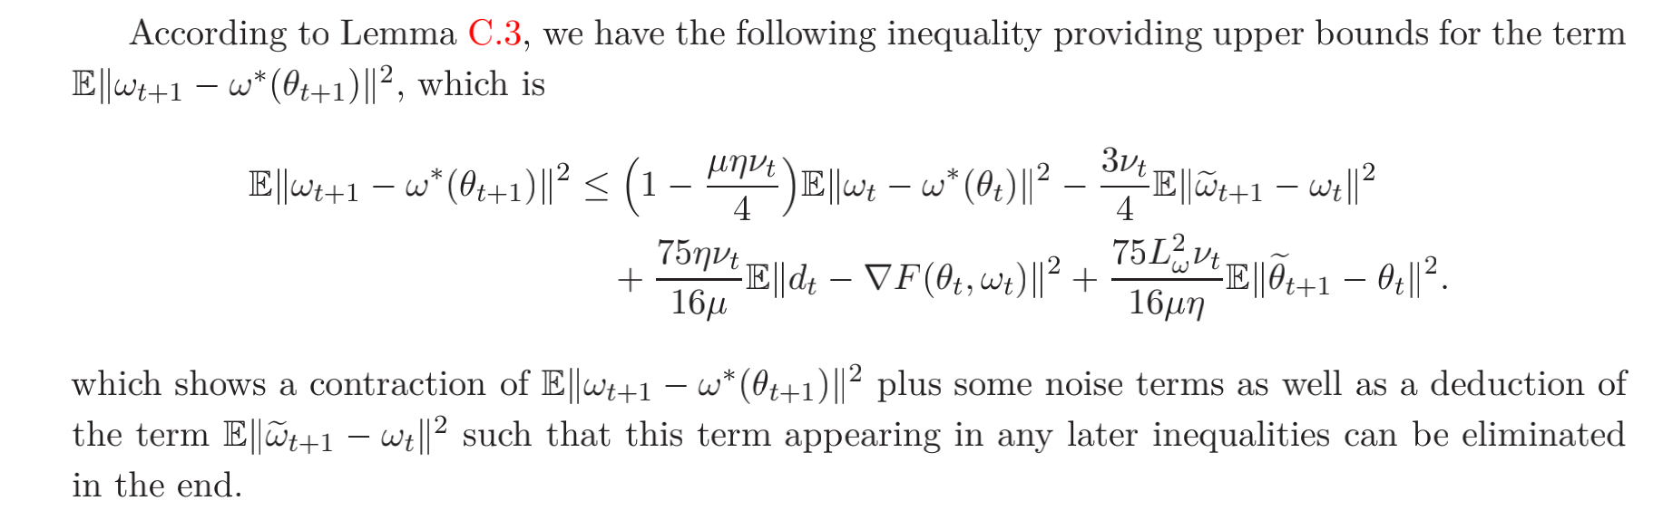
7 Proofs for Algorithm 2

Slide 16
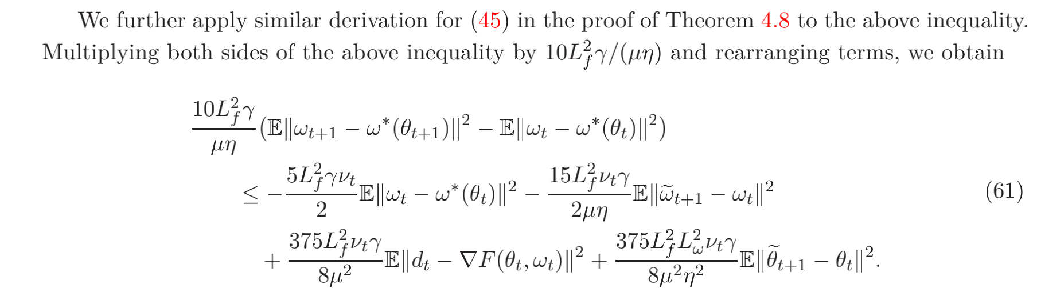
7 Proofs for Algorithm 2

Slide 17

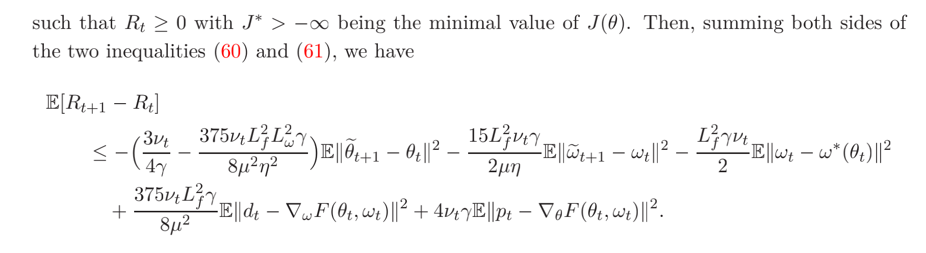
7 Proofs for Algorithm 2

Slide 18
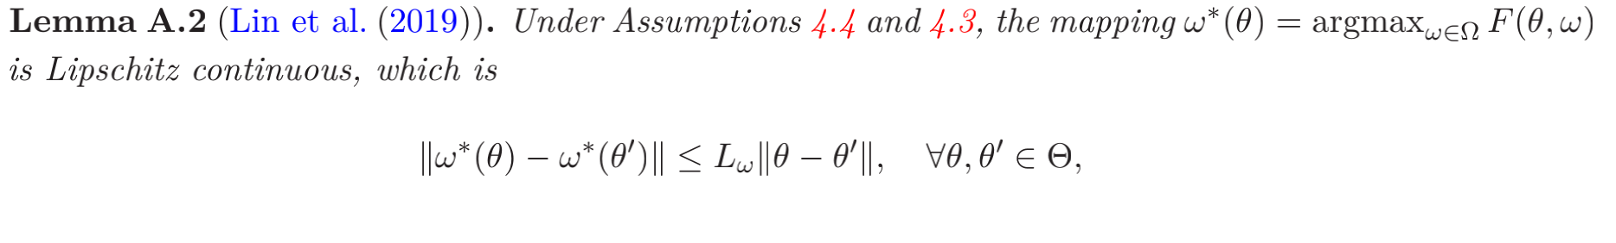
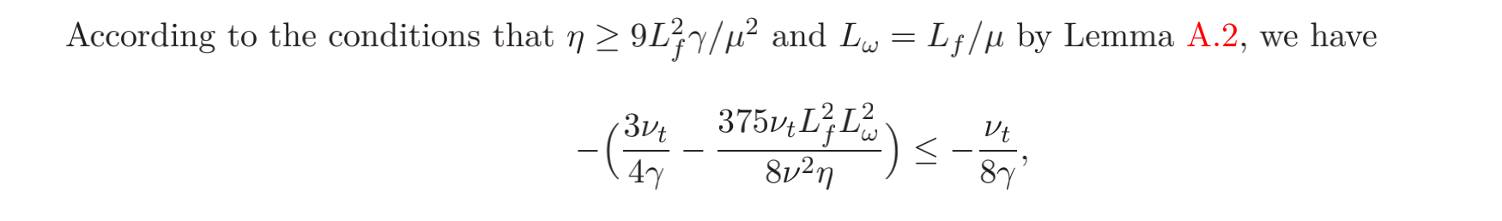
7 Proofs for Algorithm 2

Slide 19
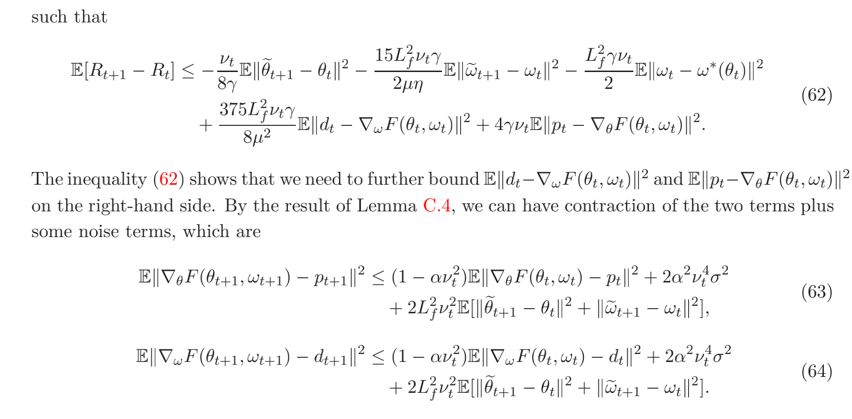
7 Proofs for Algorithm 2

Slide 20
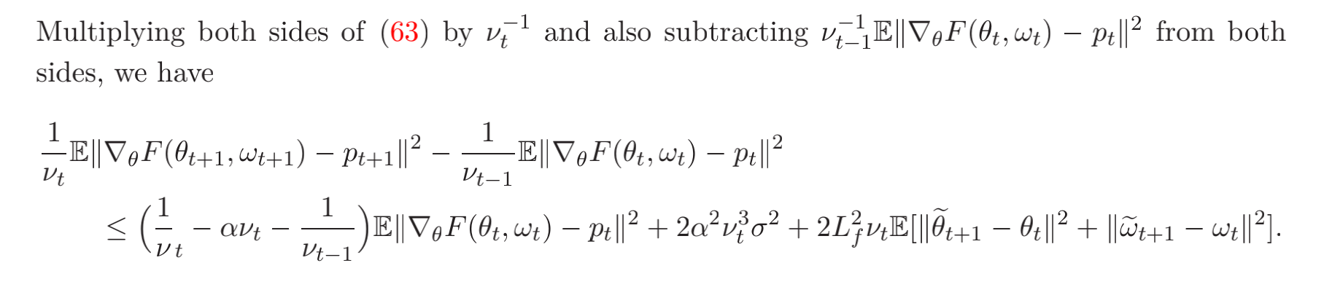
7 Proofs for Algorithm 2

Slide 21
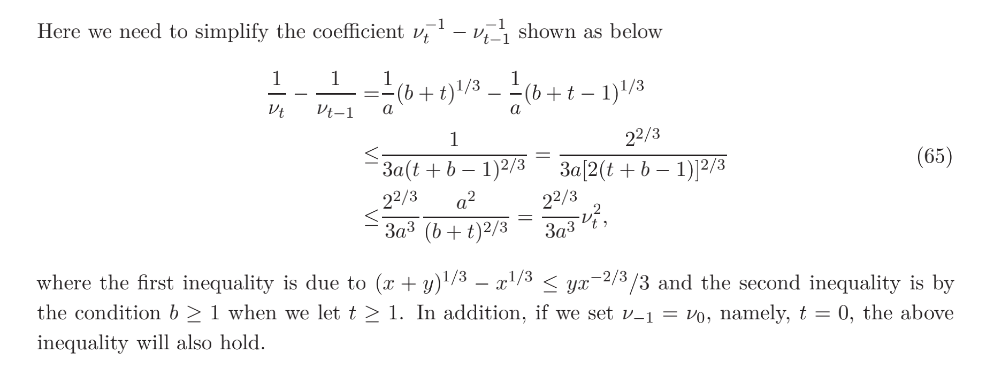
7 Proofs for Algorithm 2

Slide 22
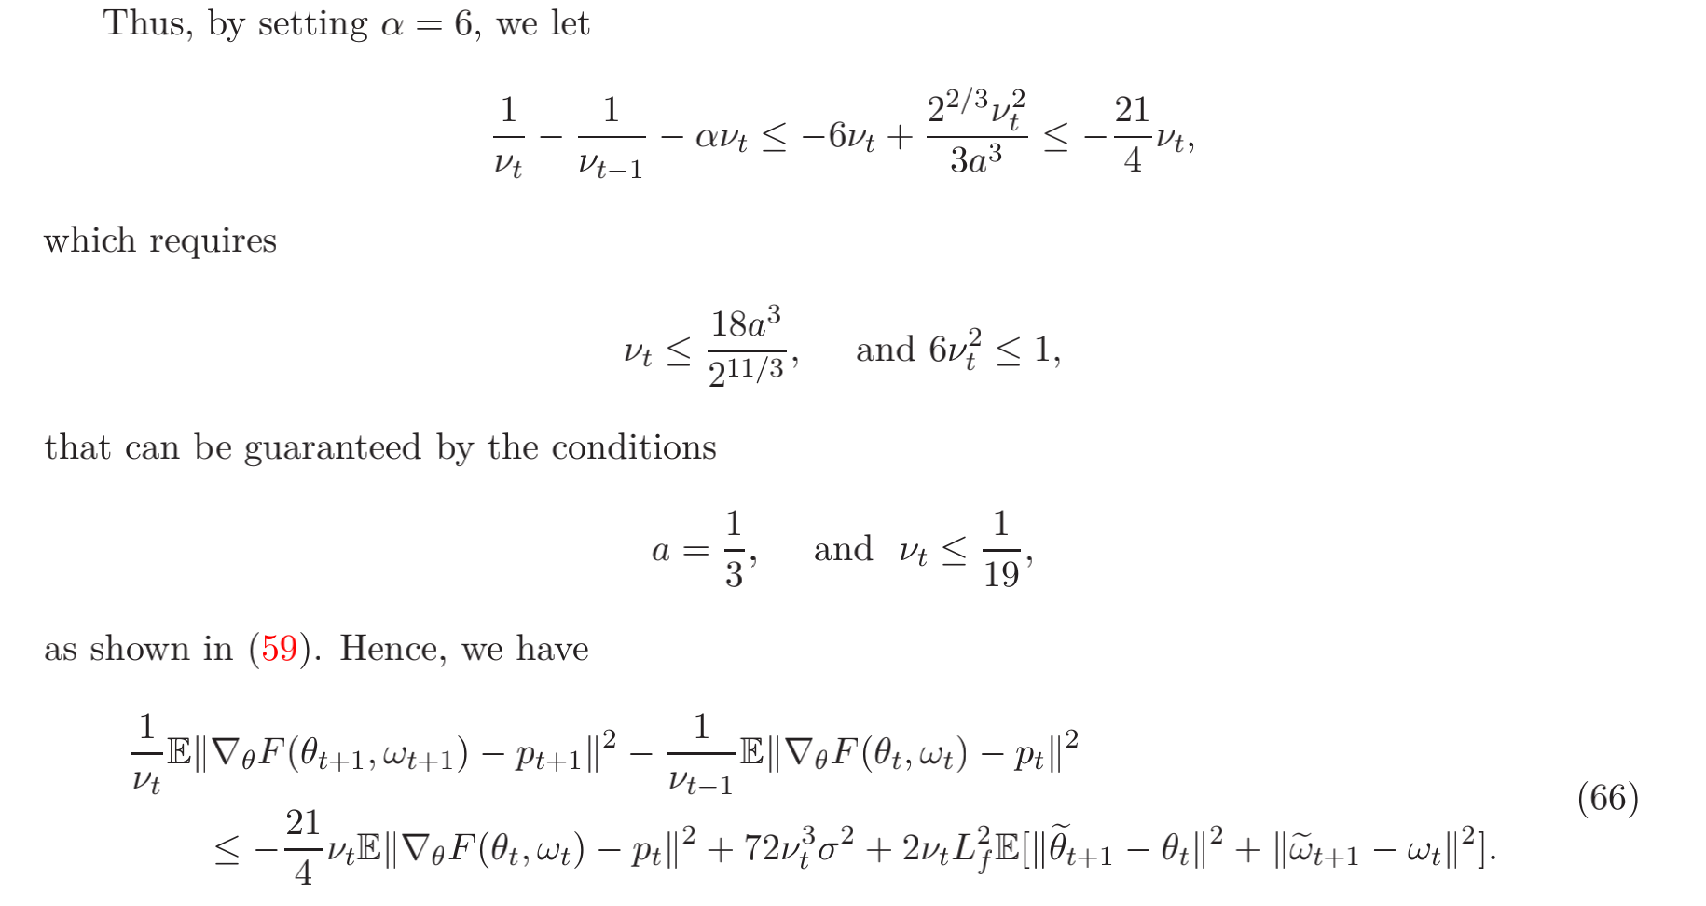
7 Proofs for Algorithm 2

Slide 23
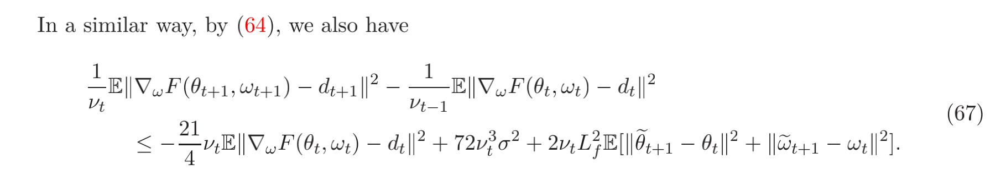
7 Proofs for Algorithm 2

Slide 24
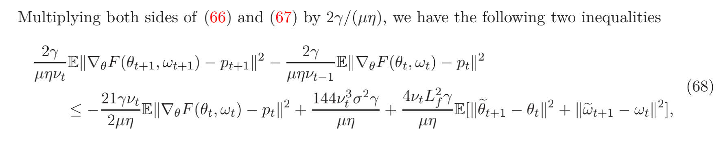
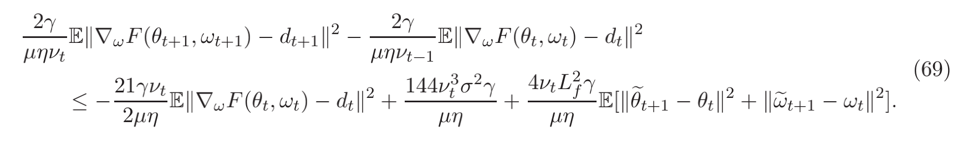
7 Proofs for Algorithm 2

Slide 25
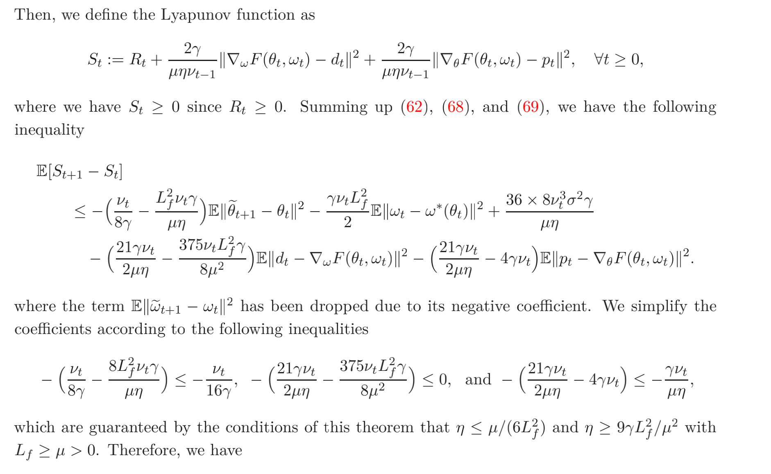
7 Proofs for Algorithm 2

Slide 26
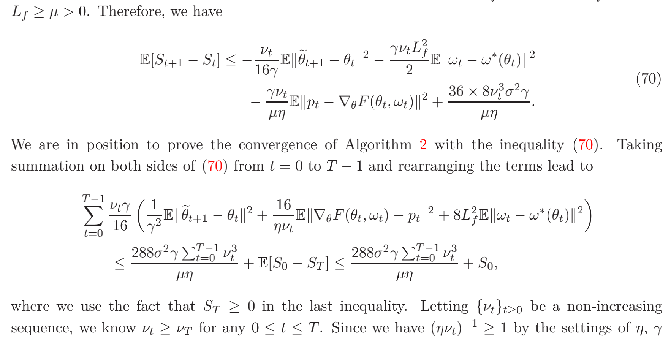
7 Proofs for Algorithm 2

Slide 27
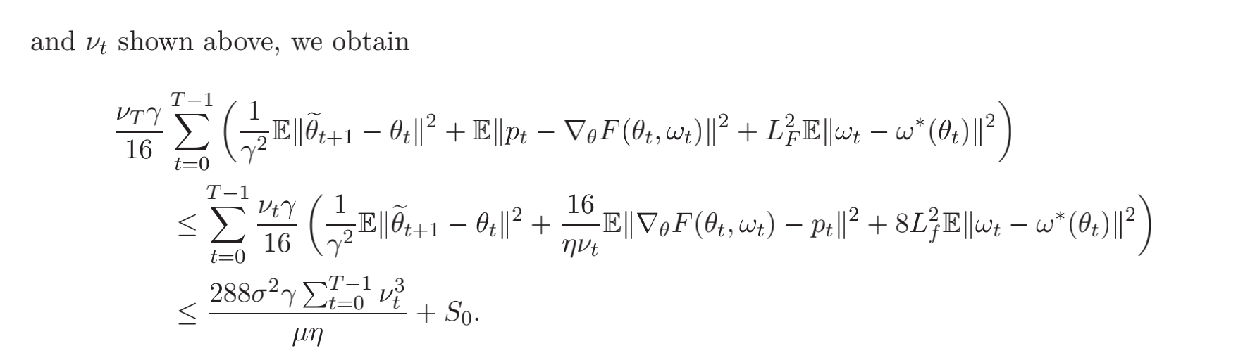
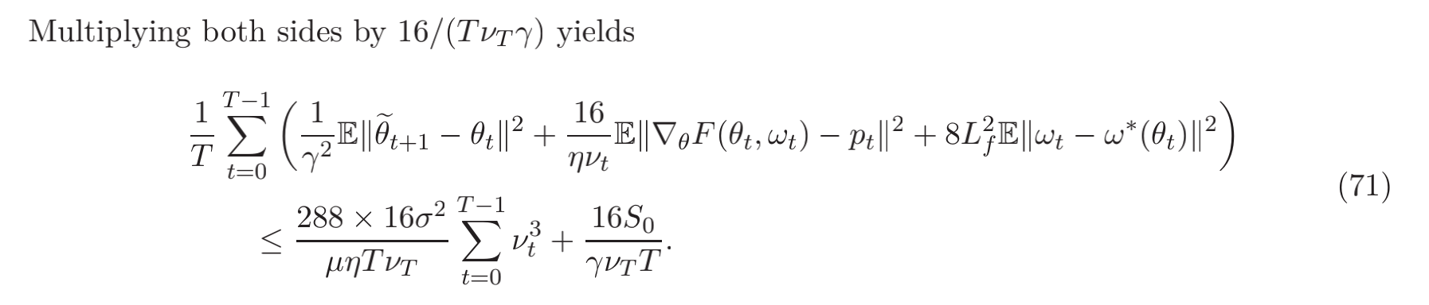
7 Proofs for Algorithm 2

Slide 28
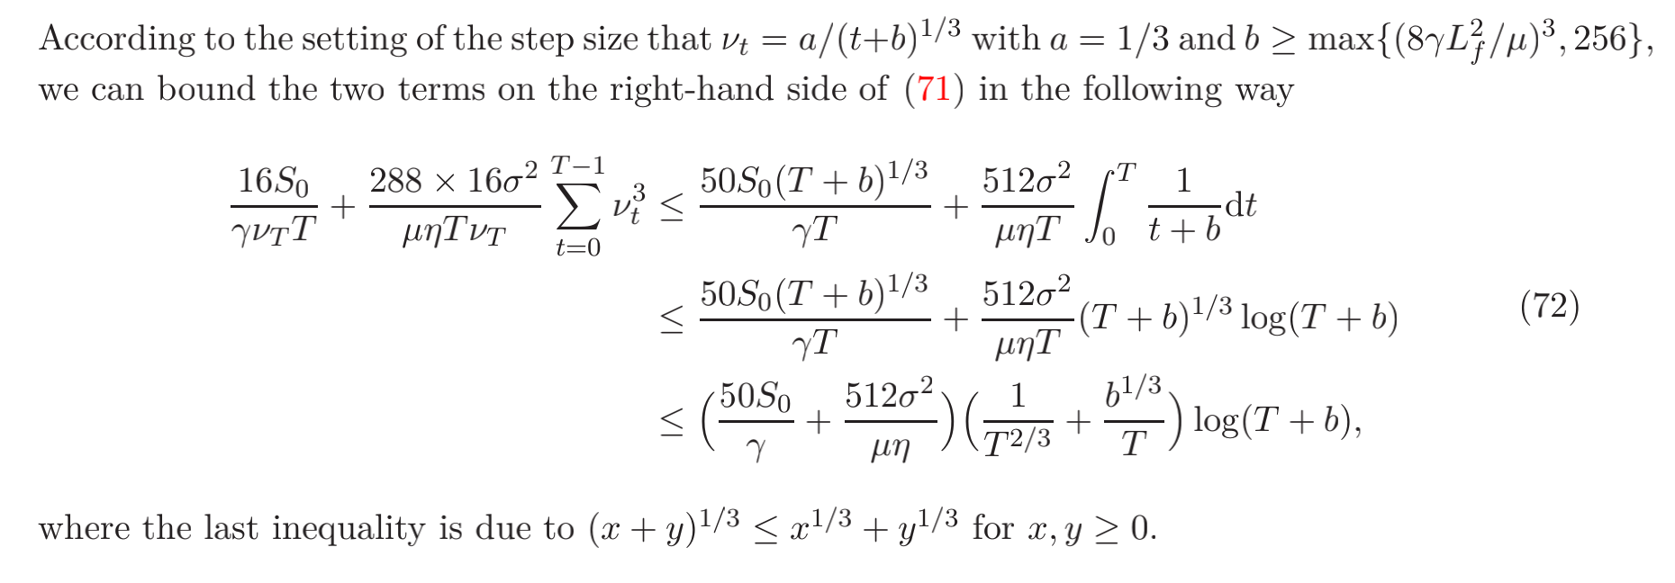
7 Proofs for Algorithm 2

Slide 29
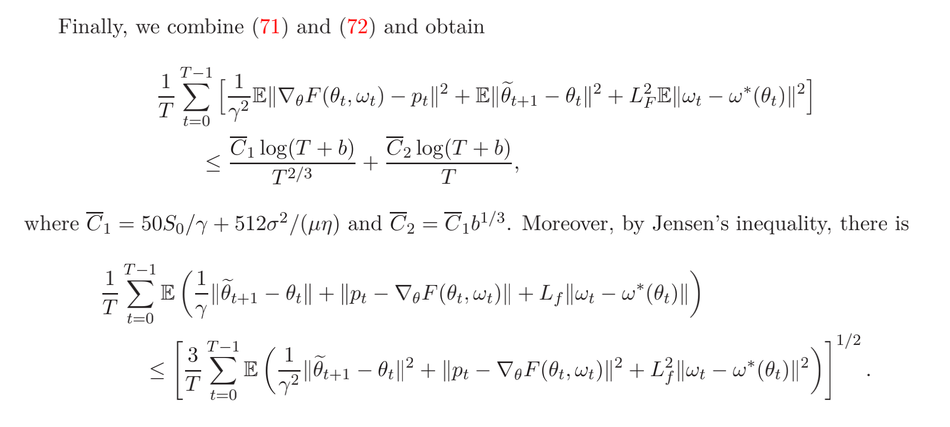
7 Proofs for Algorithm 2

Slide 30
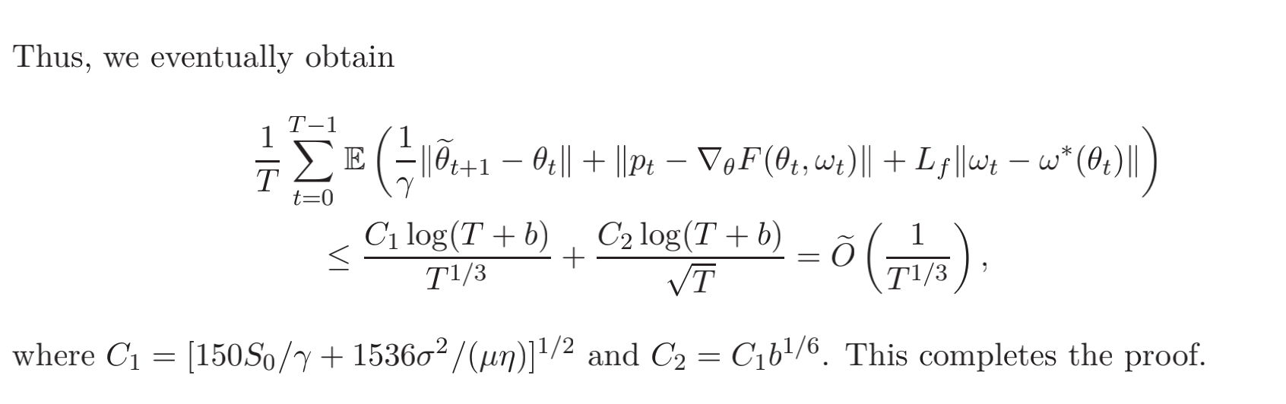
7 Proofs for Algorithm 2

Slide 31
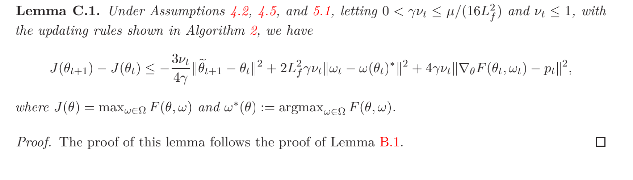
8.1 Proof for Lemma C.1

Slide 32
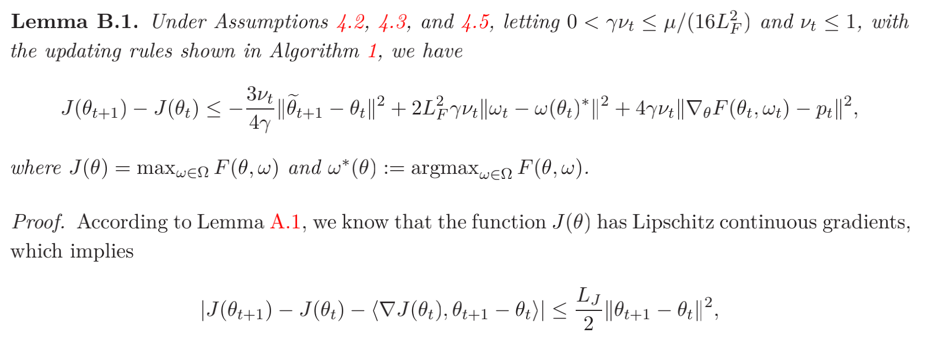
8.1 Proof for Lemma C.1

Slide 33
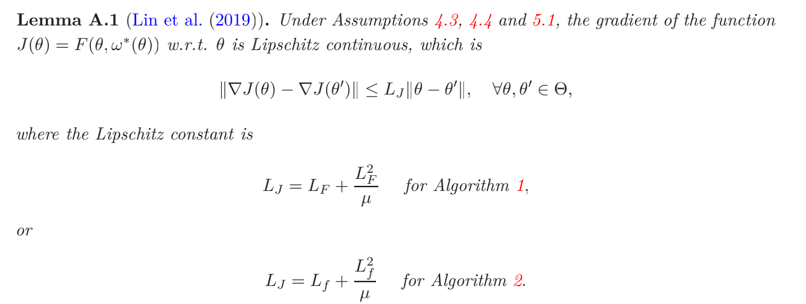
8.1 Proof for Lemma C.1

Slide 34
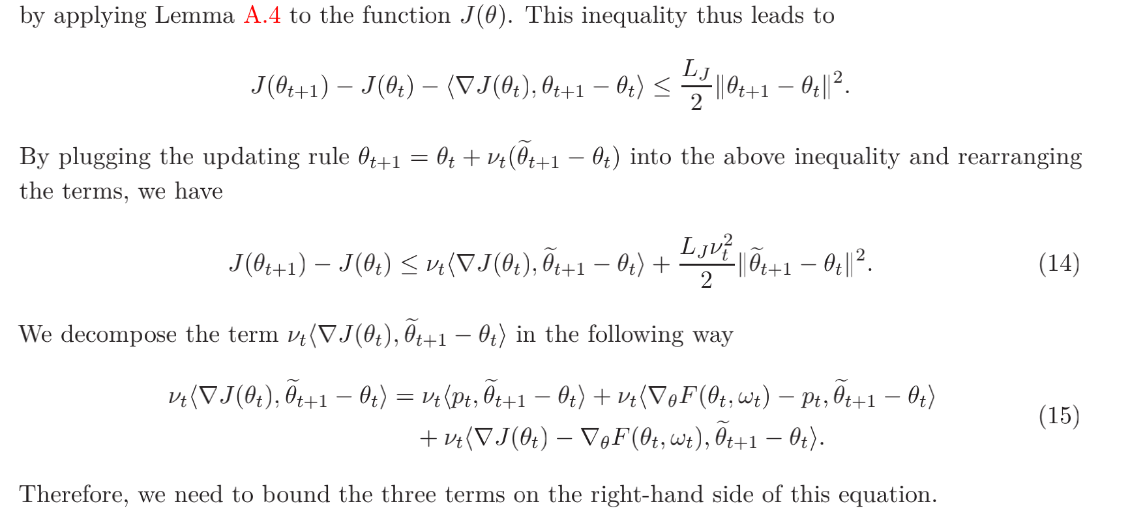
8.1 Proof for Lemma C.1

Slide 35
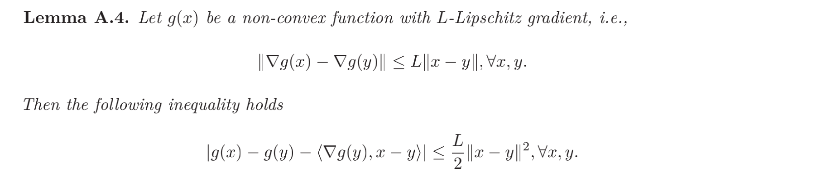
8.1 Proof for Lemma C.1

Slide 36
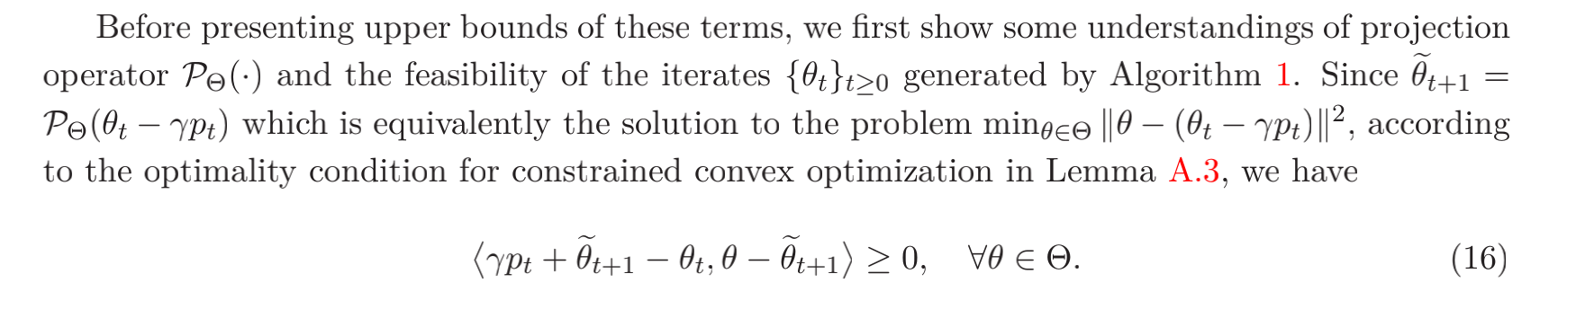
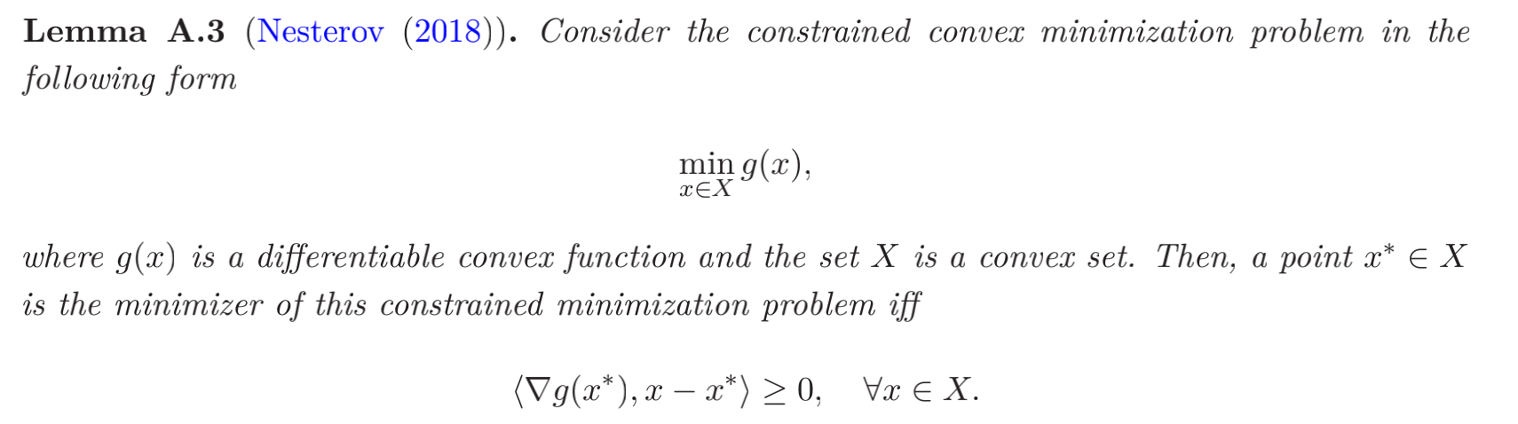
8.1 Proof for Lemma C.1

Slide 37
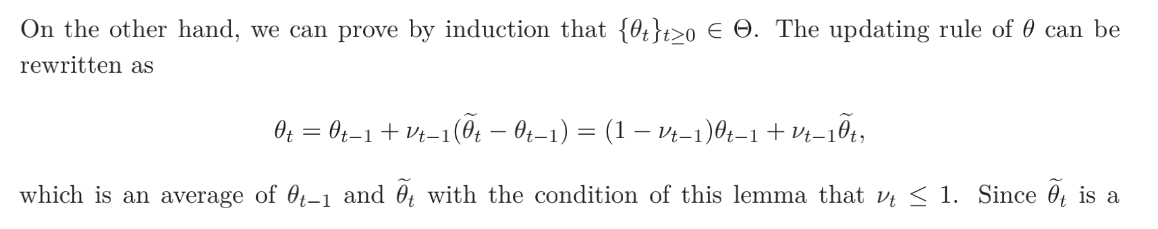
8.1 Proof for Lemma C.1

Slide 38
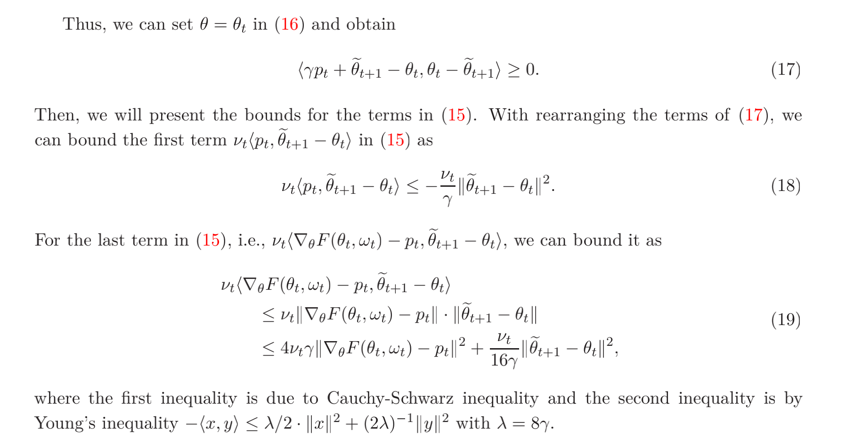
8.1 Proof for Lemma C.1

Slide 39
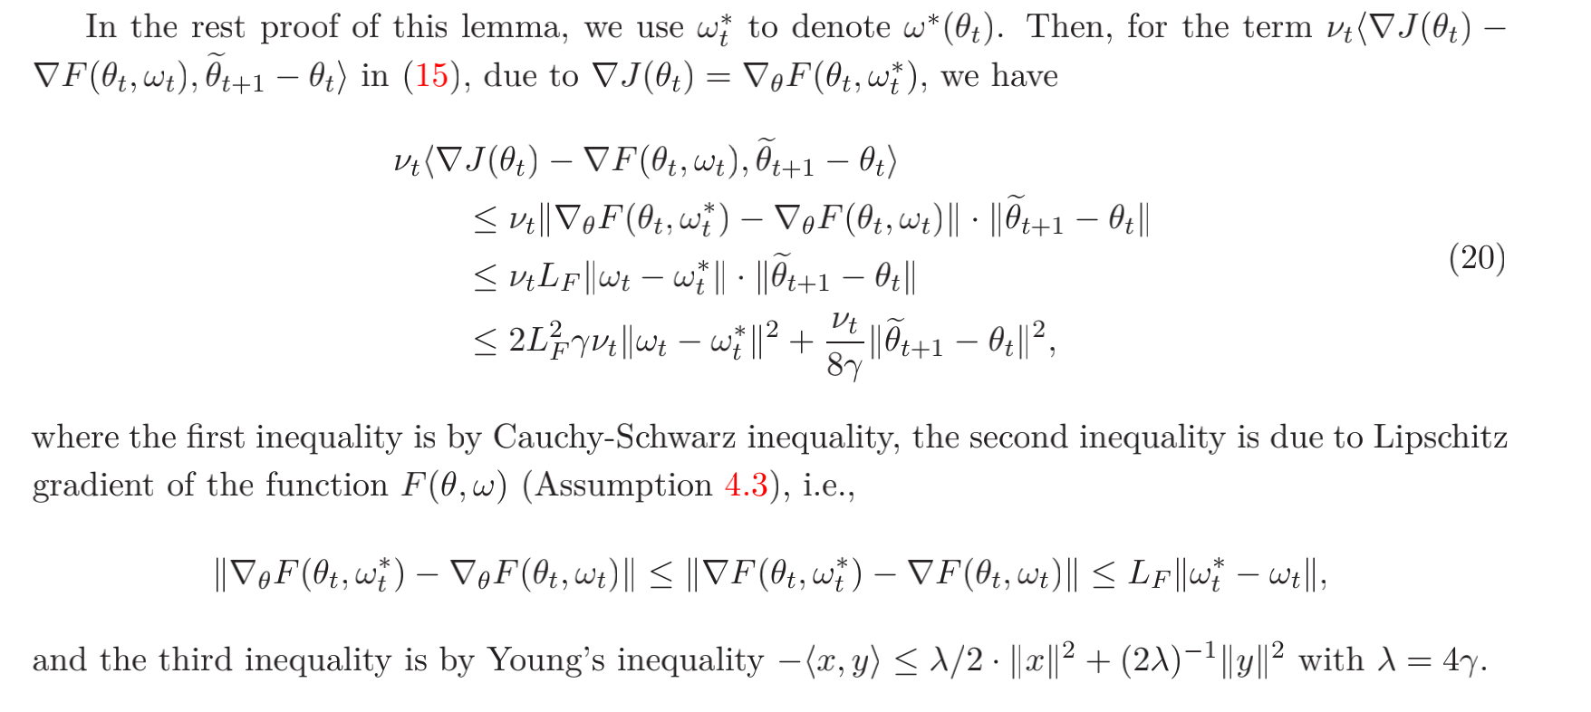
8.1 Proof for Lemma C.1

Slide 40
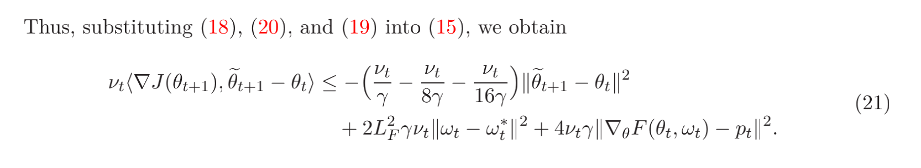
8.1 Proof for Lemma C.1

Slide 41
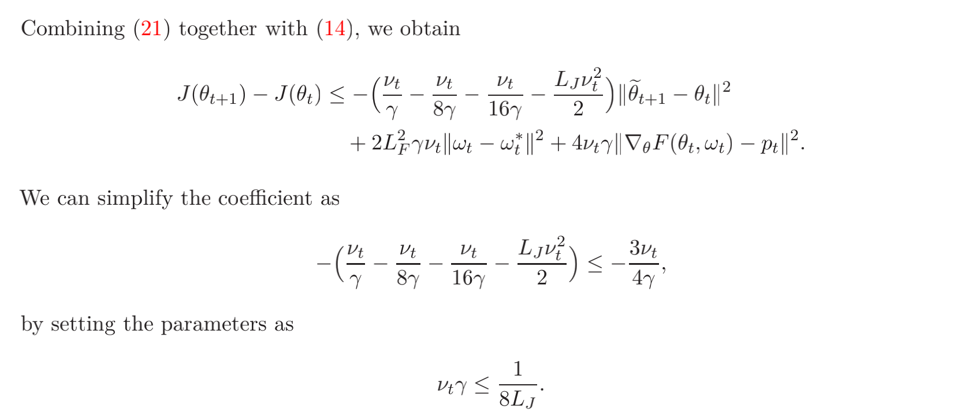
8.1 Proof for Lemma C.1

Slide 42
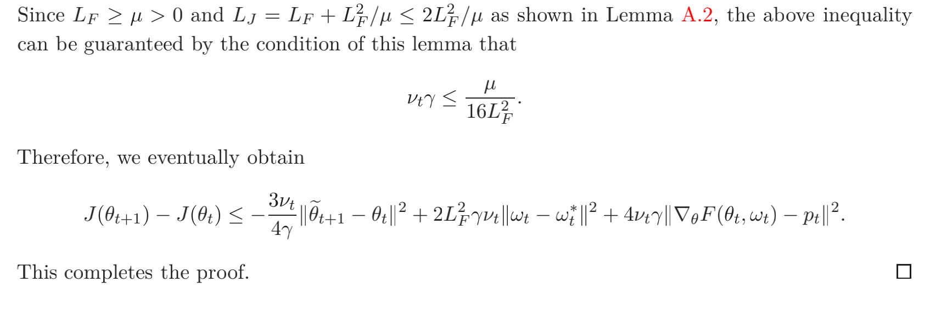
8.1 Proof for Lemma C.1

Slide 43
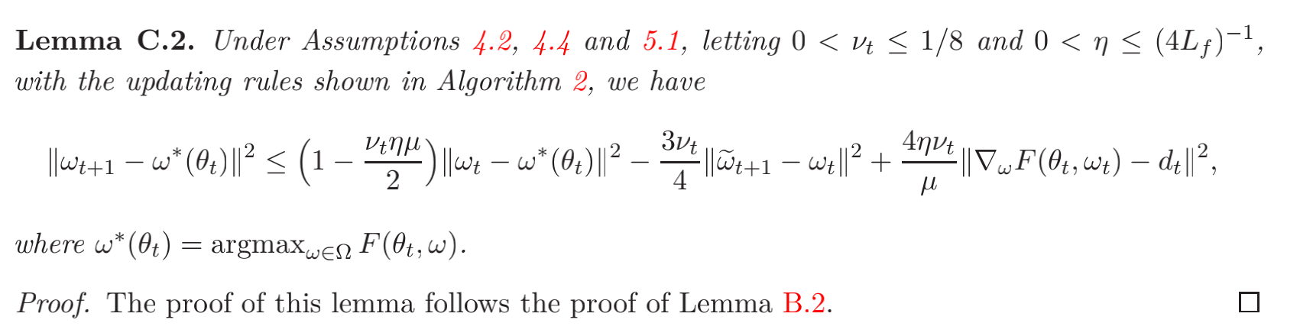
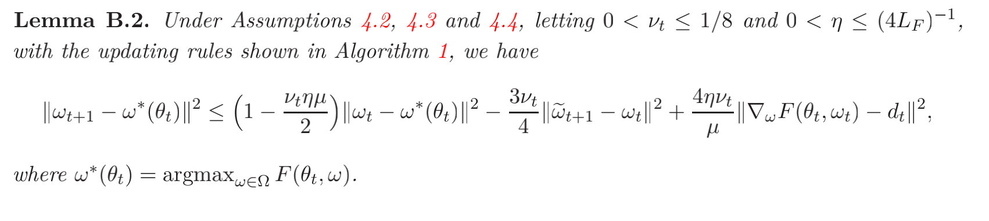
8.2 Proof for Lemma C.2

Slide 44

8.2 Proof for Lemma C.2

Slide 45

8.2 Proof for Lemma C.2

Slide 46

8.2 Proof for Lemma C.2

Slide 47

8.2 Proof for Lemma C.2

Slide 48

8.2 Proof for Lemma C.2

Slide 49

8.2 Proof for Lemma C.2

Slide 50

8.2 Proof for Lemma C.2

Slide 51

8.2 Proof for Lemma C.2

Slide 52

8.2 Proof for Lemma C.2

Slide 53

8.2 Proof for Lemma C.2

Slide 54


8.3 Proof for Lemma C.3

Slide 55


8.3 Proof for Lemma C.3

Slide 56

8.3 Proof for Lemma C.3

Slide 57

8.3 Proof for Lemma C.3

Slide 58

8.3 Proof for Lemma C.3

Slide 59

8.4 Proof for Lemma C.4

Slide 60

8.4 Proof for Lemma C.4

Slide 61

8.4 Proof for Lemma C.4

Slide 62

8.4 Proof for Lemma C.4

Slide 63


8.4 Proof for Lemma C.4

Slide 64

8.4 Proof for Lemma C.4

Slide 65

8.4 Proof for Lemma C.4

Slide 66

8.4 Proof for Lemma C.4

